Slide 1


Smart Traffic Lights
Team 14
Vasilis Vlassopoulos
Georgia Georgiou

Slide 2
General Problem
At night, drivers are often required to wait at traffic lights even when the junction is empty. Additionally, some traffic signals may remain green despite minimal or no vehicles present, while other lanes experience a high volume of traffic.
Congestion Build-Up​
Traffic light delays create bottlenecks, causing stop-and-go conditions that lead to backlogs along major roads.​
Driver Frustration and Aggressive Driving​
Prolonged waiting and slow progress increase driver frustration, leading some drivers to engage in aggressive maneuvers like ,rapid lane changes, which disrupts the flow further.​
High Traffic Volumes​
Growing numbers of vehicles, especially during rush hours, lead to heavy traffic approaching key intersections.​
Traffic Light Inefficiencies​
Outdated or poorly synchronized traffic lights struggle to handle the heavy load, leading to longer wait times and more frequent stops. Also drivers at night are forced to wait at the traffic light while the junction is empty.​

Slide 3
General Problem
High Traffic Volumes
Traffic Light Inefficiencies
Congestion Build-Up
Driver Frustration and Aggressive Driving

Slide 4
Solution
Traffic Light Camera
Smart Traffic Light
Traffic light color changes to reduce congestion.
Uploading data to the cloud
Camera captures photos of road at a certain refresh rate.
Raspberry Pi
Raspberry Pi takes the photos from the camera, analyses them and changes the color of the traffic lights dynamically.
Saving data to cloud for further processing and evaluating results.
Smart /manual management
Traffic lights can automatically be adjusted and manually in case of an emergency.

Slide 5
Our Customers
City and Municipal Governments: Cities with heavy traffic congestion look for ways to improve traffic flow and reduce commute times for residents.​
Transportation Departments: State and federal transportation departments may fund or directly purchase smart traffic solutions for larger, high-priority urban areas or highways.
Any public organization that is responsible for traffic on the roads.

Slide 6


Implemented Functions / Client
View the current state of each traffic light in every junction.
View statistics (Waiting cars at the moment, congestion based on waiting cars of the previous day).

Slide 7


Implemented Functions / Admin
Views the statistics (Congestion based on waiting cars of the previous day).
Manual control of traffic lights by admin while monitoring for safety rule violations. The admin can:
Set the period in seconds (with specific limits).
Control if the “mode” of a specific junction is manual or dynamic.
Views the current state of each traffic light in every junction
Views snapshot of a specific traffic light.

Slide 8
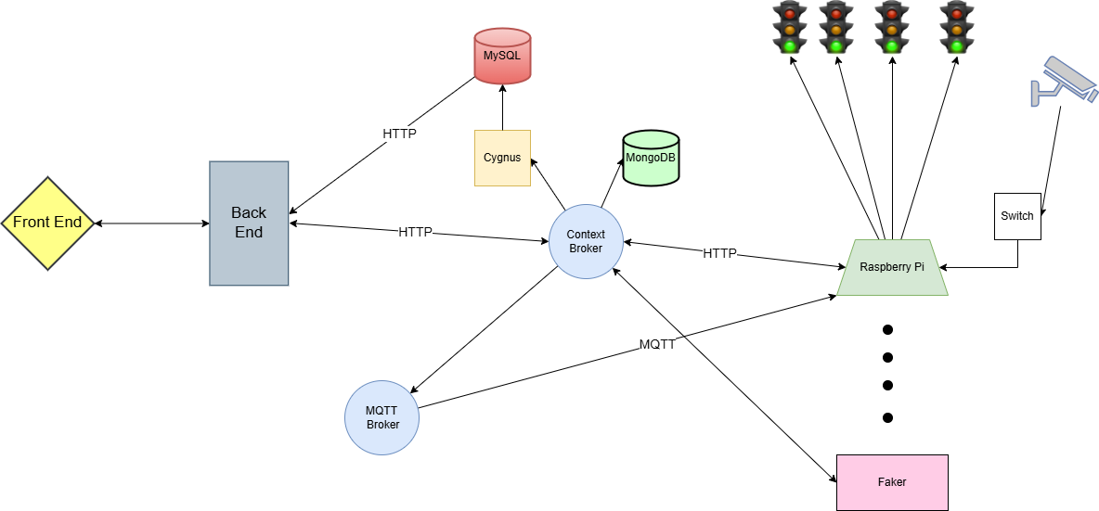
Architecture

Slide 9
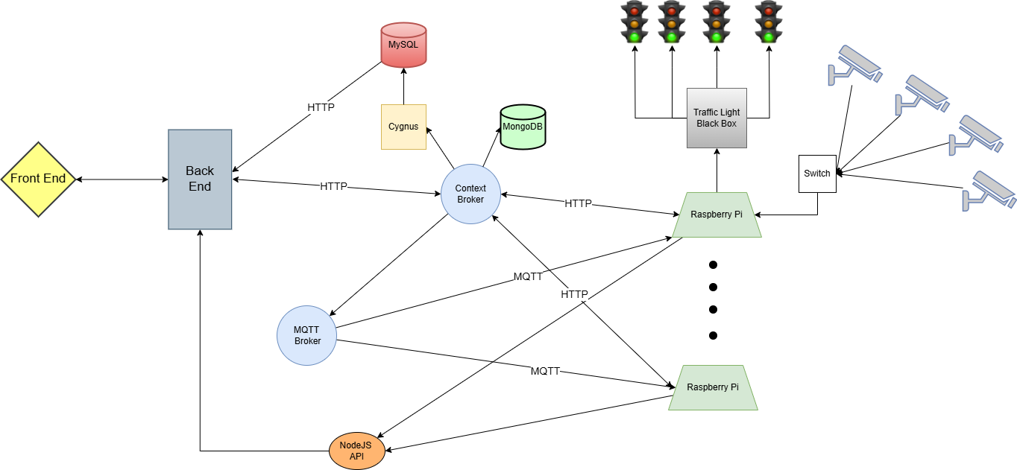
Real Architecture

Slide 10
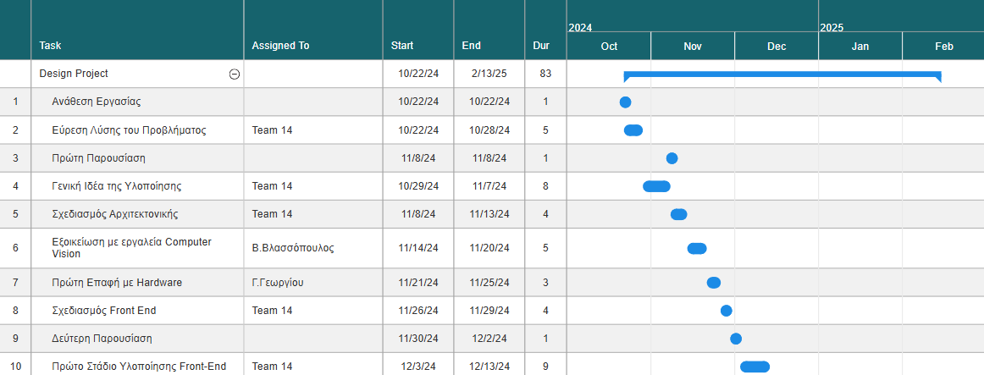
Project Timeline

Slide 11
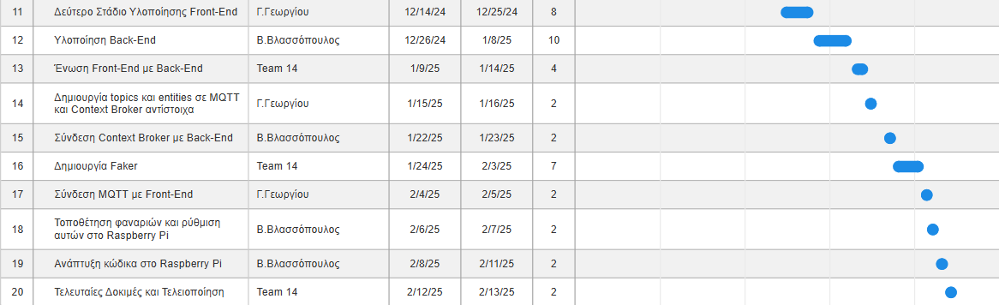
Project Timeline

Slide 12
Challenges we encountered
To accommodate all user and admin scenarios, the code became quite complex and, in many cases, required the execution of multiple actions.
Due to the large amount of data, we had to carefully determine the optimal timing for subscribing to each topic to minimize the app's data usage.

Slide 13
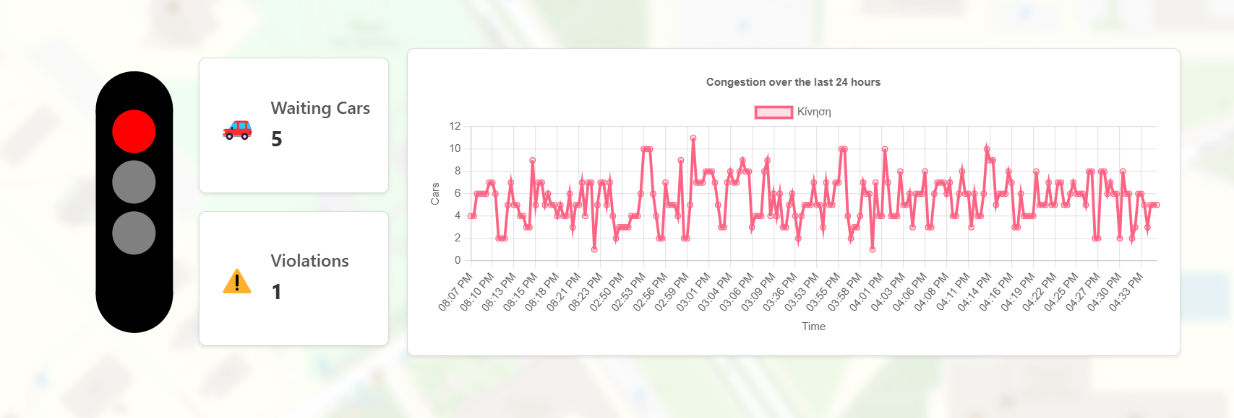
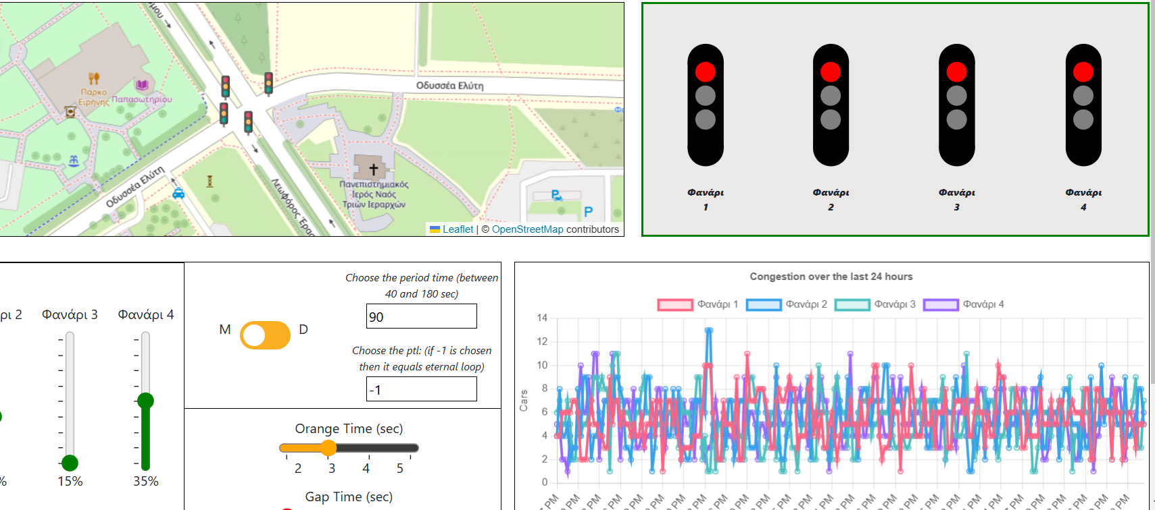
Demo

Slide 14
What we didn’t implement..
Recording of rule violations (e.g., running a red light) and notifying the admin.
Recognition of emergency vehicles and corresponding adjustment of traffic lights.

Slide 15
Video

Slide 16
Thank you!

